Slide 1

CSE
Machine
457
Learning
Introduction
Fall 2025

Slide 2

Course Contents
•
•
•
•
•
•
Introduction
Probabilistic Models
Tree Based Models
SVM
Ensemble Methods -
Ensemble Methods -
• Linear Models
• Neural Networks
• Unsupervised Learning - I
•
•
•
Unsupervised Learning - II
Generative Models
Semi-supervised Learning
I
II

Slide 3

Grading Policy
•
•
•
•
•
Attendance - 10%
Assignment – 10%
CT - 20%
Mid - 20%
Final - 40%

Slide 4

Text Books
1.
Machine Learning
Action by Peter
Harrington
in
Mahl
learnl
IN ACTL
F
(
2.
Pattern Recognition and
machine learning by
Christopher M Bishop
Peter llrinqton
l o oe

Slide 5

Machine Learning
A computer program is said to learn from experience E with respect to
some class of task T
and performance measure P, if
its
performance
at
task T as measured by P improves with
experience E.
•
Supervised Learning
o
Classification
■
Binary, Multiclass, Multilabel
o
Regression
•
•
Unsupervised Learning
Reinforcement Learning

Slide 6
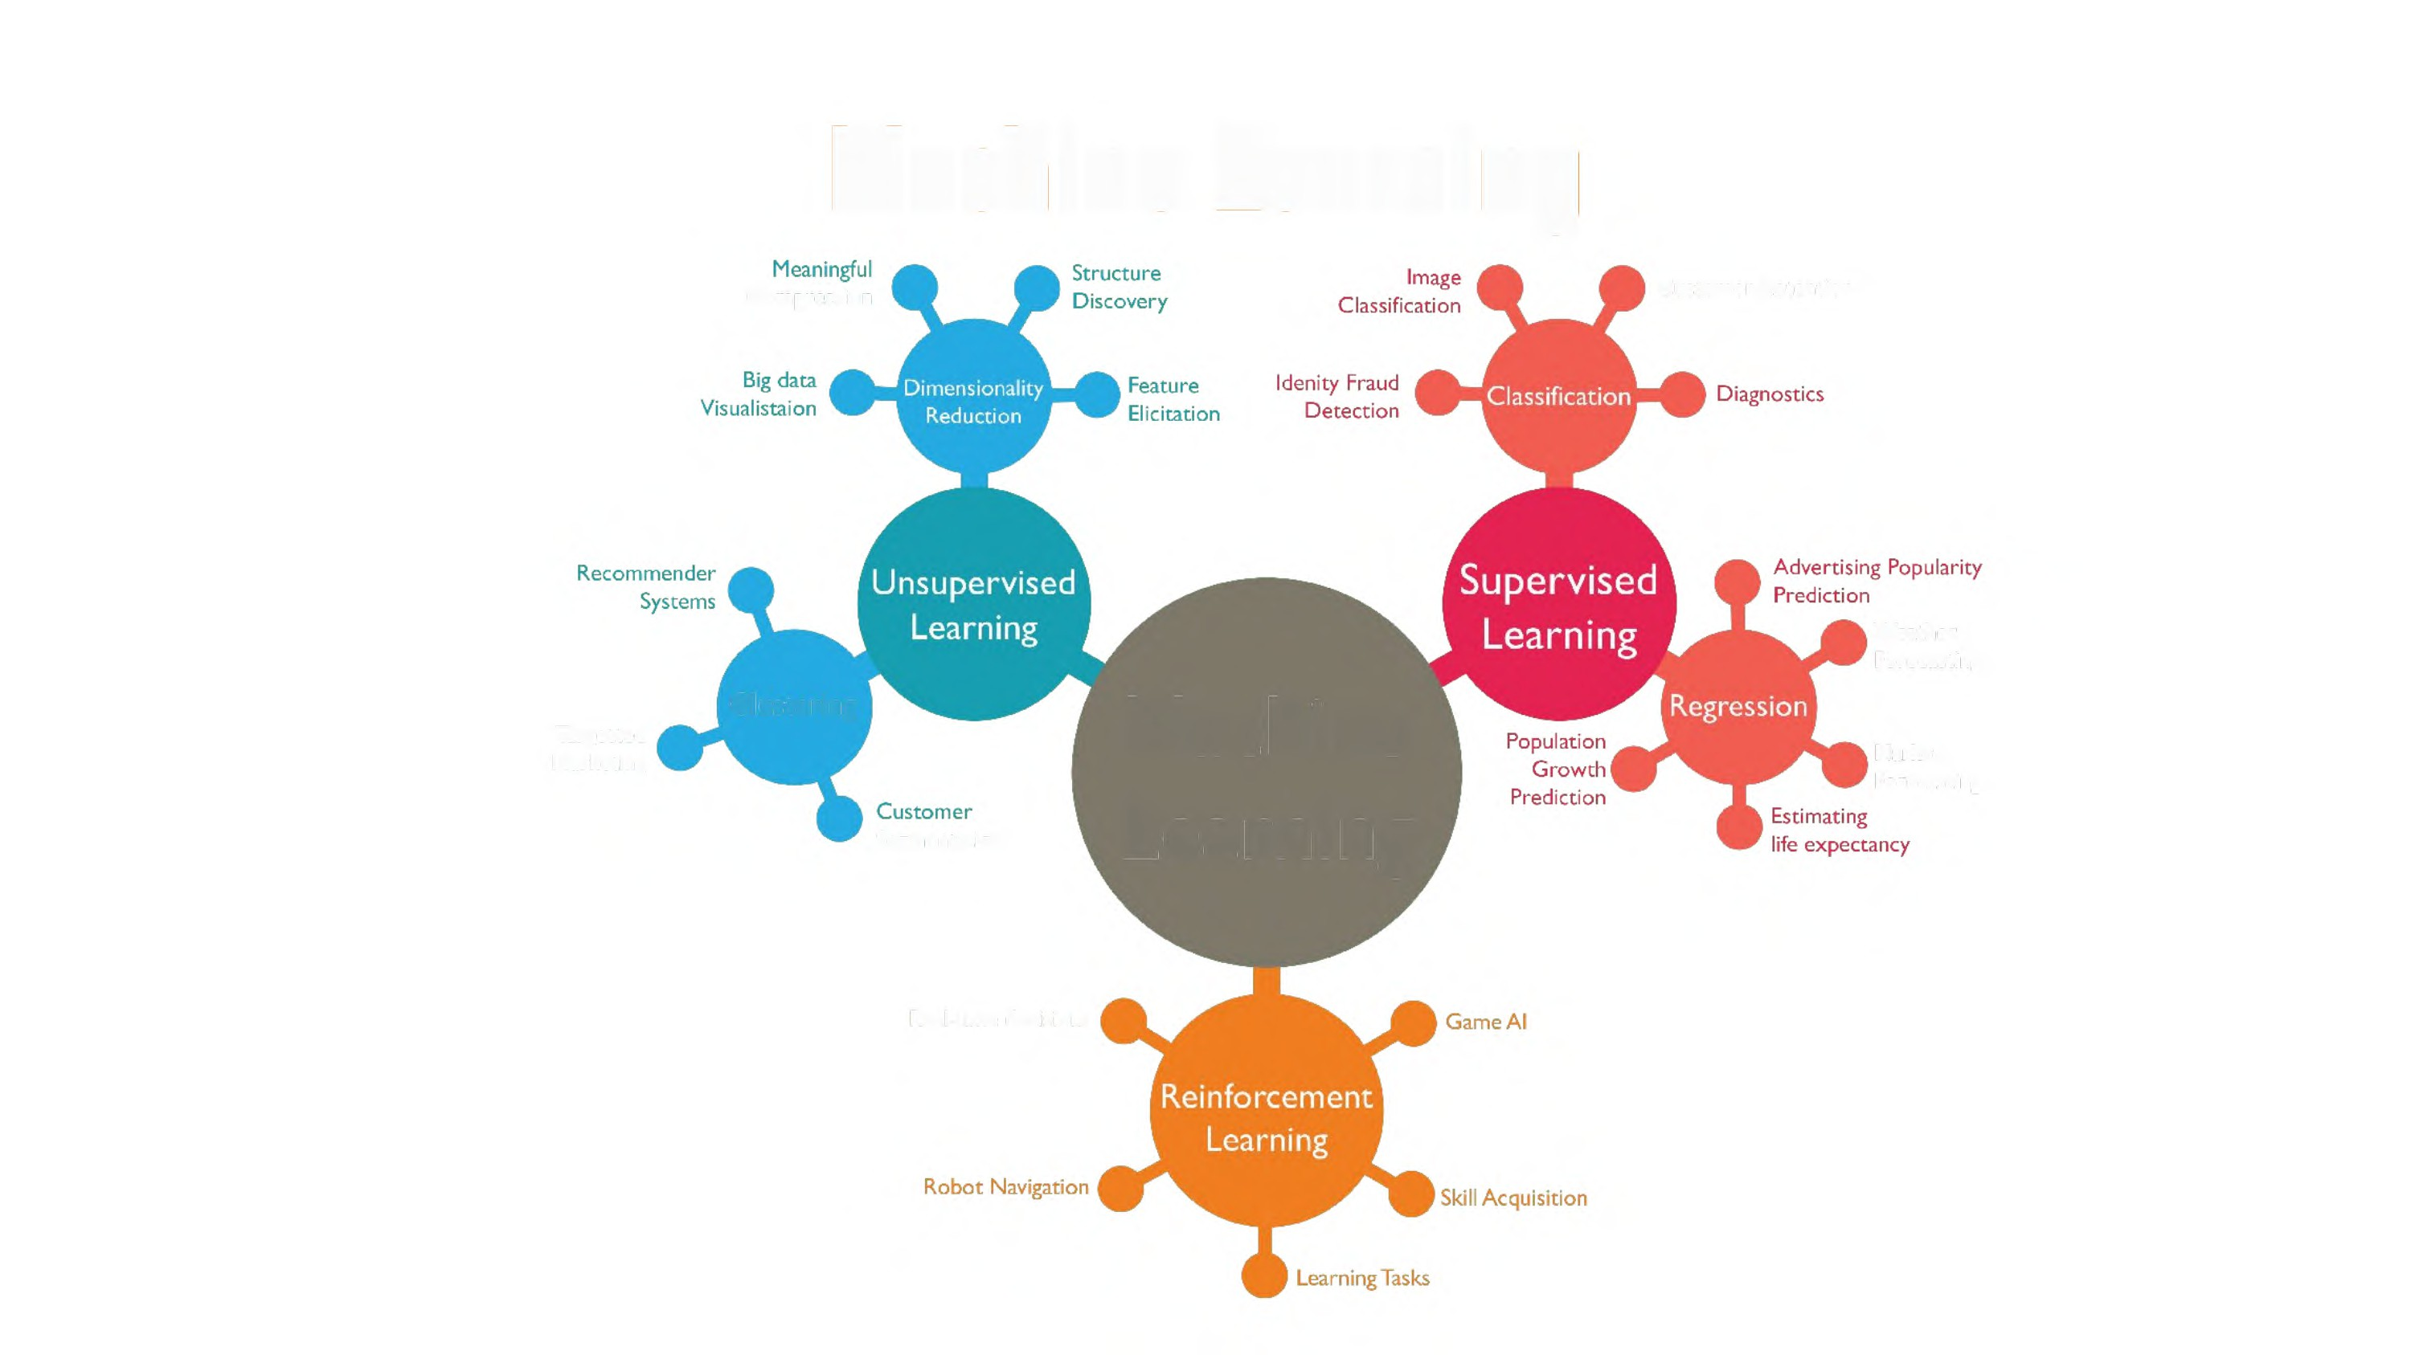
Machine
Compression
Learning
Customer Retention
Weather
Forecasting
Clustering
Machine
Learning
Targetted
Marketing
Market
Forecasting
Segmentation
Real-time decisions

Slide 7
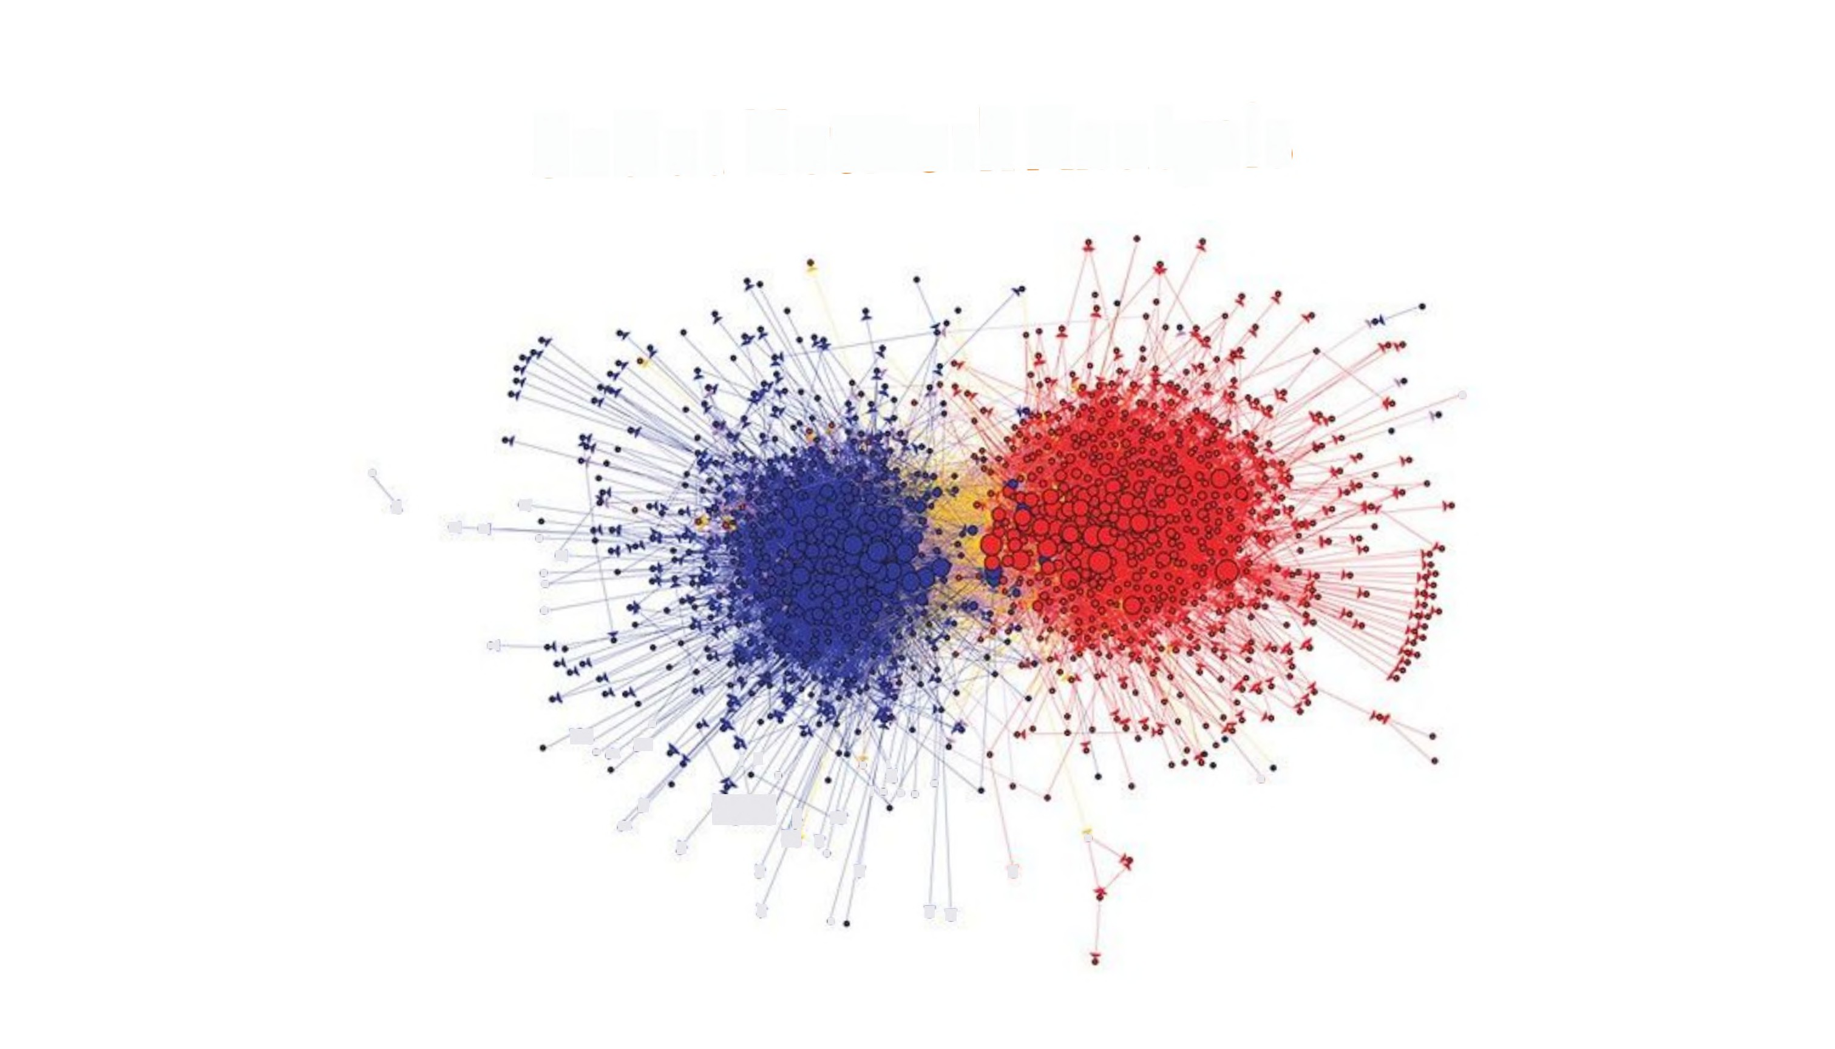
Social
Network
Analysis
•
.
$
4
.
4
4
.
.
4
•
♦(
,
....
•
+
I/
•
'% .
•
' ...
•
.,. >
^{+»},
r
r
^{r}.
A
•
t
T
~
•
TT
Notes:
Unsupervised Learning (Clustering)

Slide 8

Sentiment
Analysis
Discovering people opinions, emotions and
a product or service
feelings about
Notes:
Supervised (Classification)

Slide 9

Recommendation
System
Frequently Bought Together
Total price: $83.09
+a»aae
Add both to List
rJ This item: Structure and Interpretation of Computer Programs - 2nd Edition (MIT Electrical Engineering and... by Harold Abelson Paperback $50.50
rJ The Pragmatic Programmer: From Journeyman to Master by Andrew Hunt Paperback $32.59
Customers Who Bought This Item Also Bought
Page 1 0f 13
,
The Little Prover
ALGORITHMS
mm
The Little Schemer - 4th
Edition
» Daniel P. Friedman
rte2el64
Paperback
$36.00 Prime
Instructor's Manual Va
Structure and Interpretation
of Computer Programs..
> Gerald Jay Sussman
ttetrtr5
Paperback
$28.70 Prime
The Pragmatic
Programmer: From
Journeyman to Master
Andrew Hunt
teetek 328
Paperback
$32.59 Prime
Introduction to Algorithms,
3rd Edition (MIT Press)
» Thomas H. Cormen
pert313
GEE7I« coo.
Algorithms
Hardcover
$66.32 Prime
An Introduction to
Functional Programming
Through Lambda..
» Greg Michaelson
pert23
Paperback
$20.70 Prime
Purely Functional Data
Structures
» Chris Okasaki
pretete19
Paperback
$40.74 prime
Code: The Hidden
Language of Computer
Hardware and Software
» Charles Petzold
petetete 334
CEEI « ano
Theory
Paperback
$17.99 Prime
The Little Prover (MIT
Press)
Daniel P. Friedman
teeter#4
Paperback
$31.78 Prime
Notes:
Unsupervised Learning (Clustering)

Slide 10
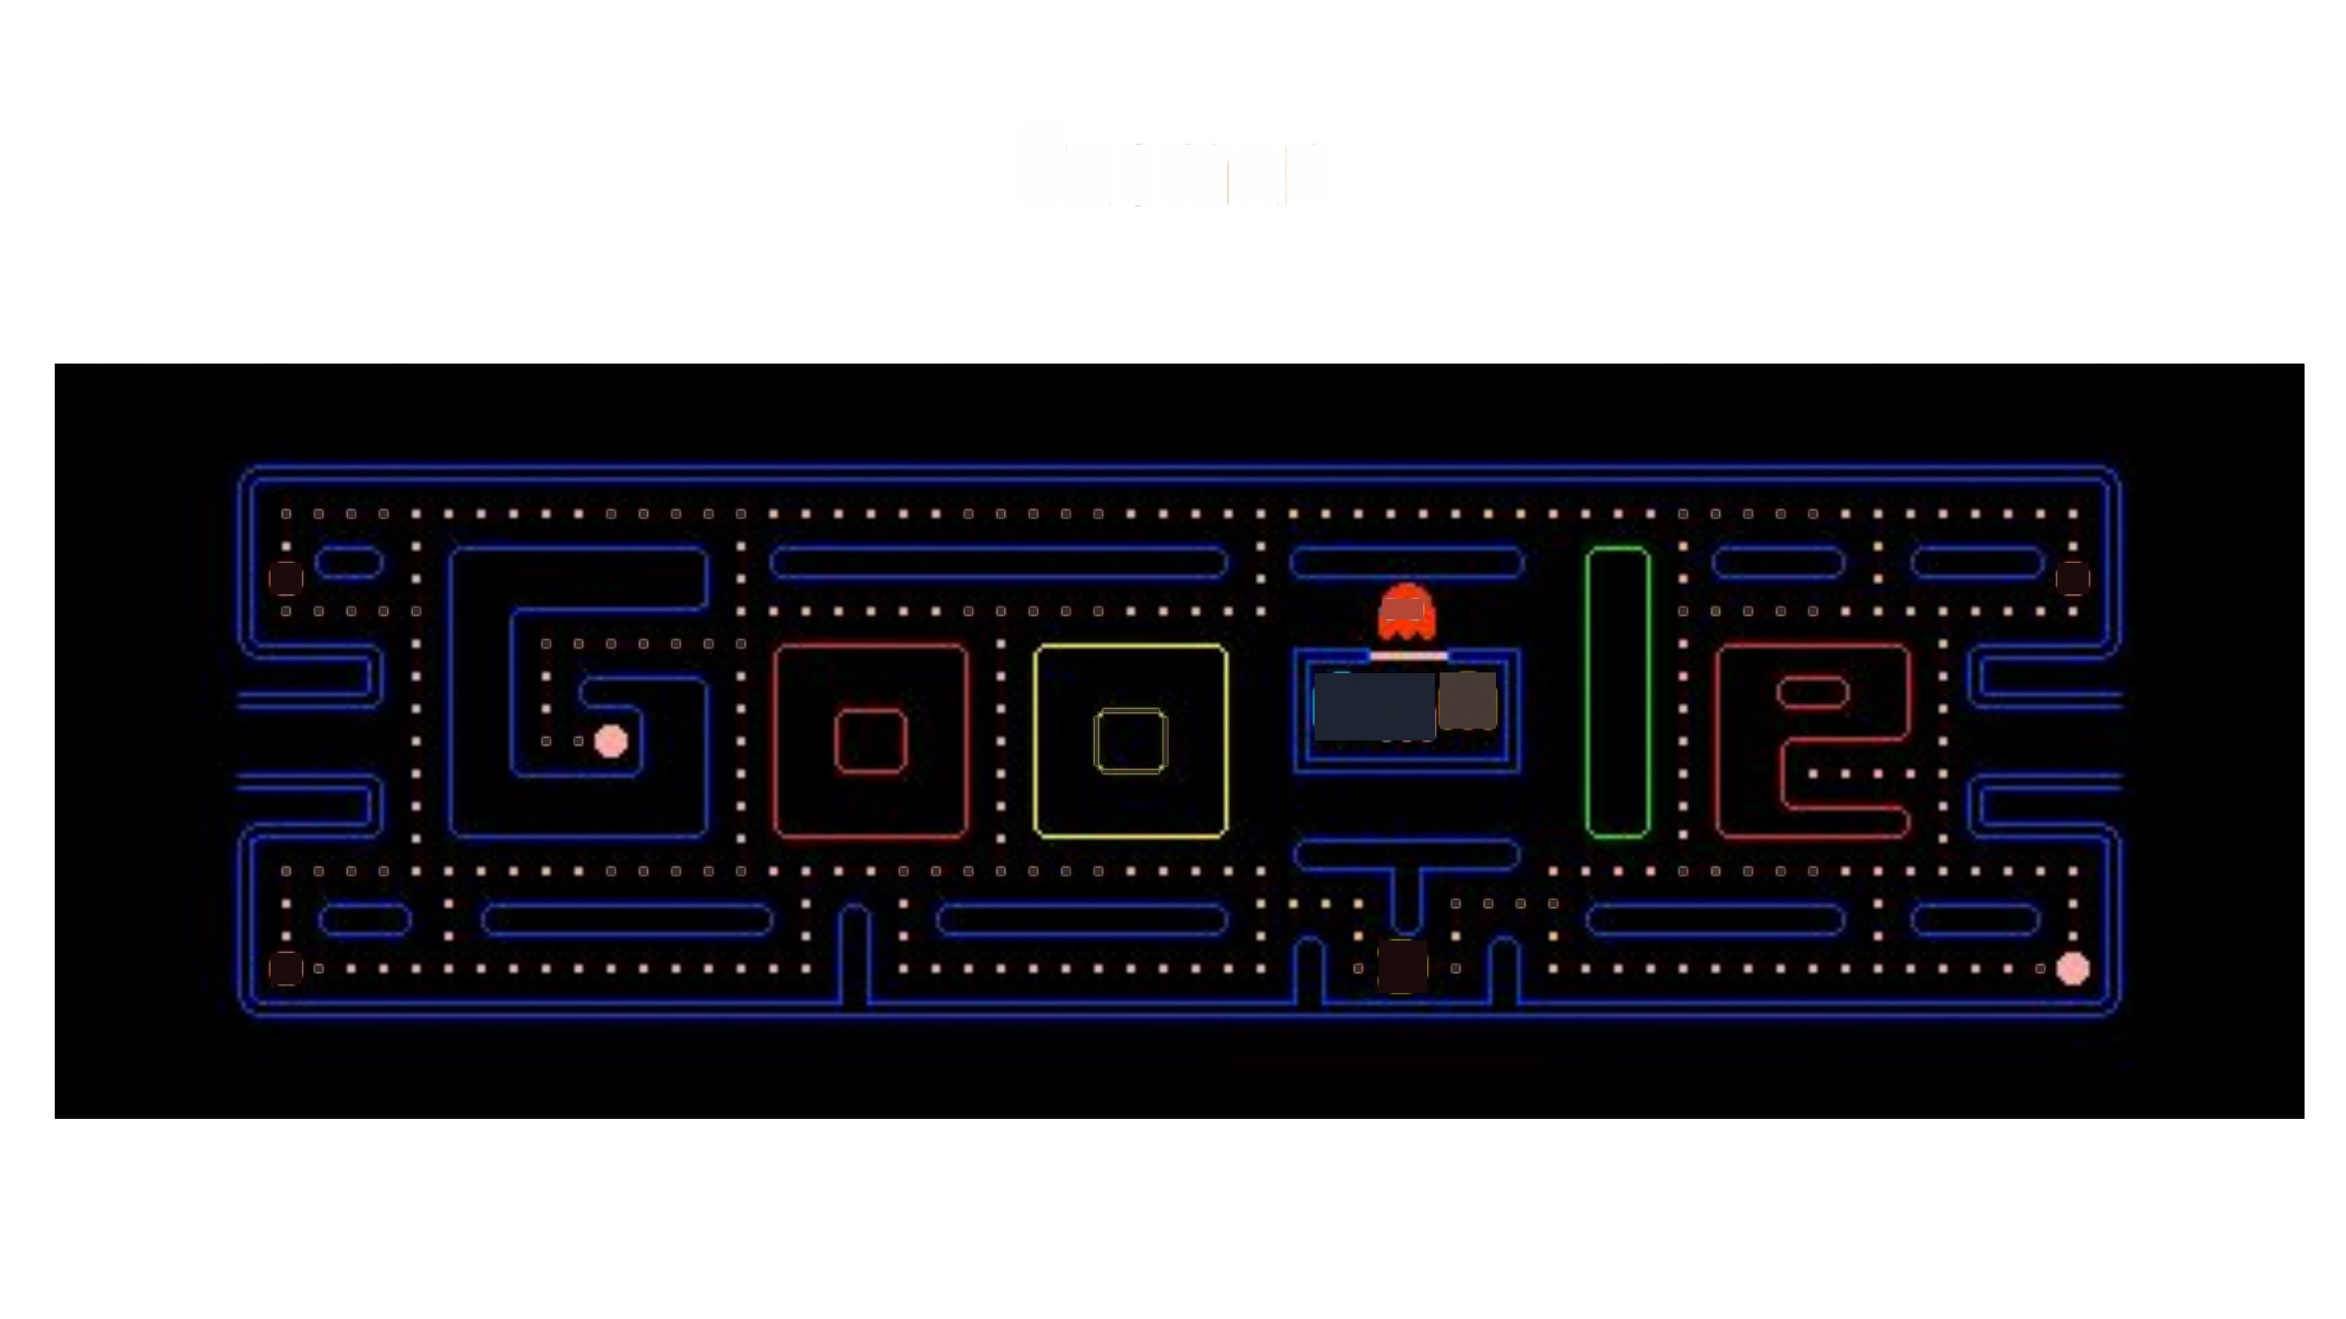
Pacman
.
•.
.
.
.
.
.
.
.
.
.
.
.
.
.
.
.
.
.
.
.
.
.
.
.
.
.
.
.
.
.
.
.
.
•
.
.
.
.
·
.
.
.
.
$
et
. .
--
I I
--
.
.
.
.
.
.
.
.
.
.
.
.
.
.
.
.
.
.
.
.
.
. .
•·
.
2
.
·
Notes:
Reinforcement Learning

Slide 11
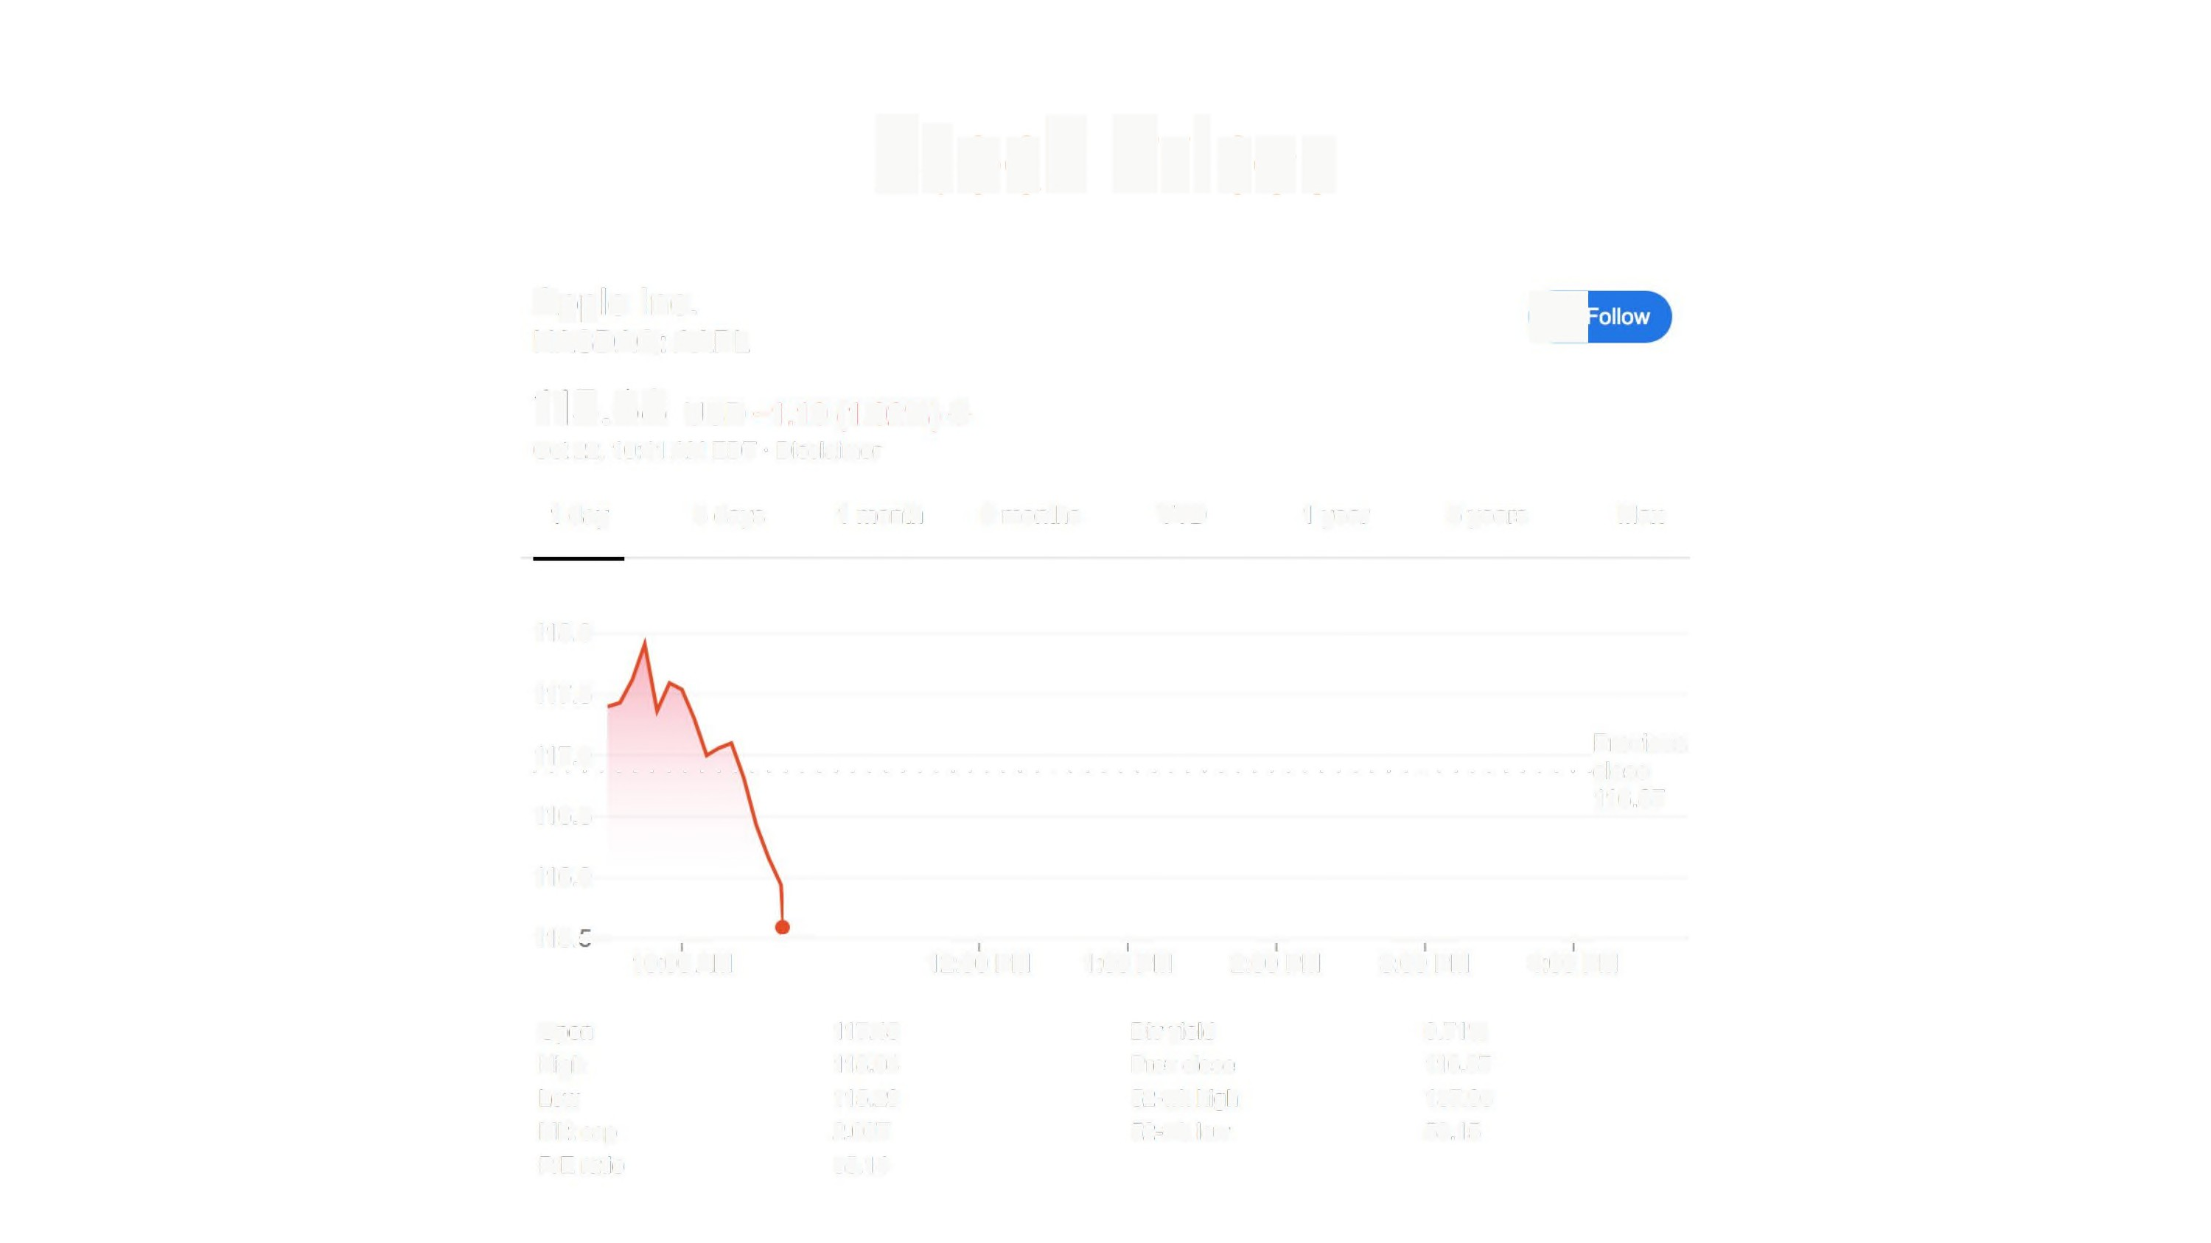
Stock
Prices
Apple Inc.
NASDAQ: AAPL
€
115.68 0sD-1.19 (1.02%) +
Oct 22, 10:41 AM EDT· Disclaimer
1 day
5 days
1 month
6 months
YTD
1 year
5 years
Max
118.0
117.5
117.0
· · · · · · · · · · · · · · · · · · · · · · · · ·
116.5
· · · · · · · · ·
· · · · · · · · · · · · · · · · · · ·
Previous
· · · ········close
116.87
116.0
115,,----~--~----~----~---~---~~---~---
10:00 AM
12:00 PM
1:00 PM 2:00 PM
3:00 PM 4:00 PM
Open
High
Low
Mktcap
P/E ratio
117.45
118.04
115.29
2.00T
35.14
Div yield
Prev close
52-wk high
52-wk low
0.71%
116.87
137.98
53.15
Notes:
Supervised Learning (Regression)

Slide 12
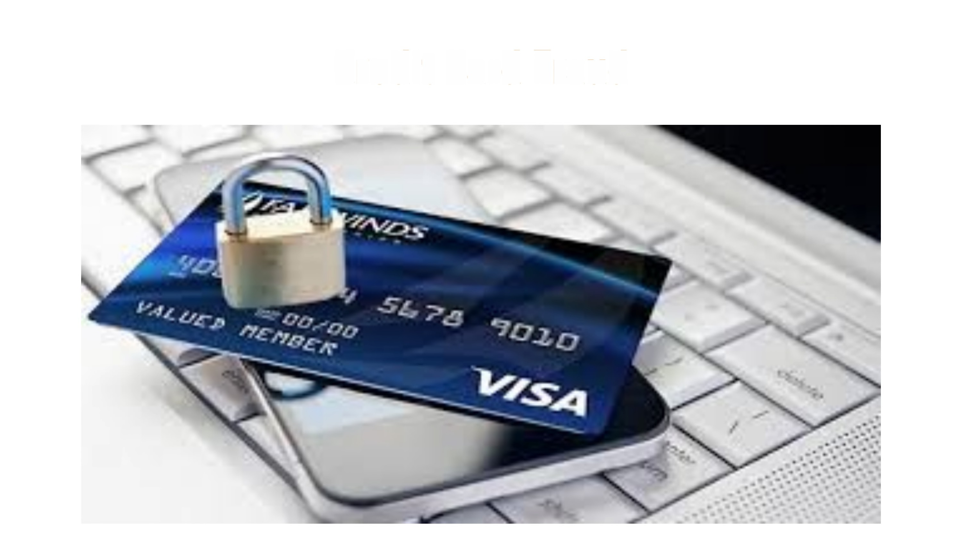
Credit Card Fraud
Notes:
Supervised (Classification)

Slide 13
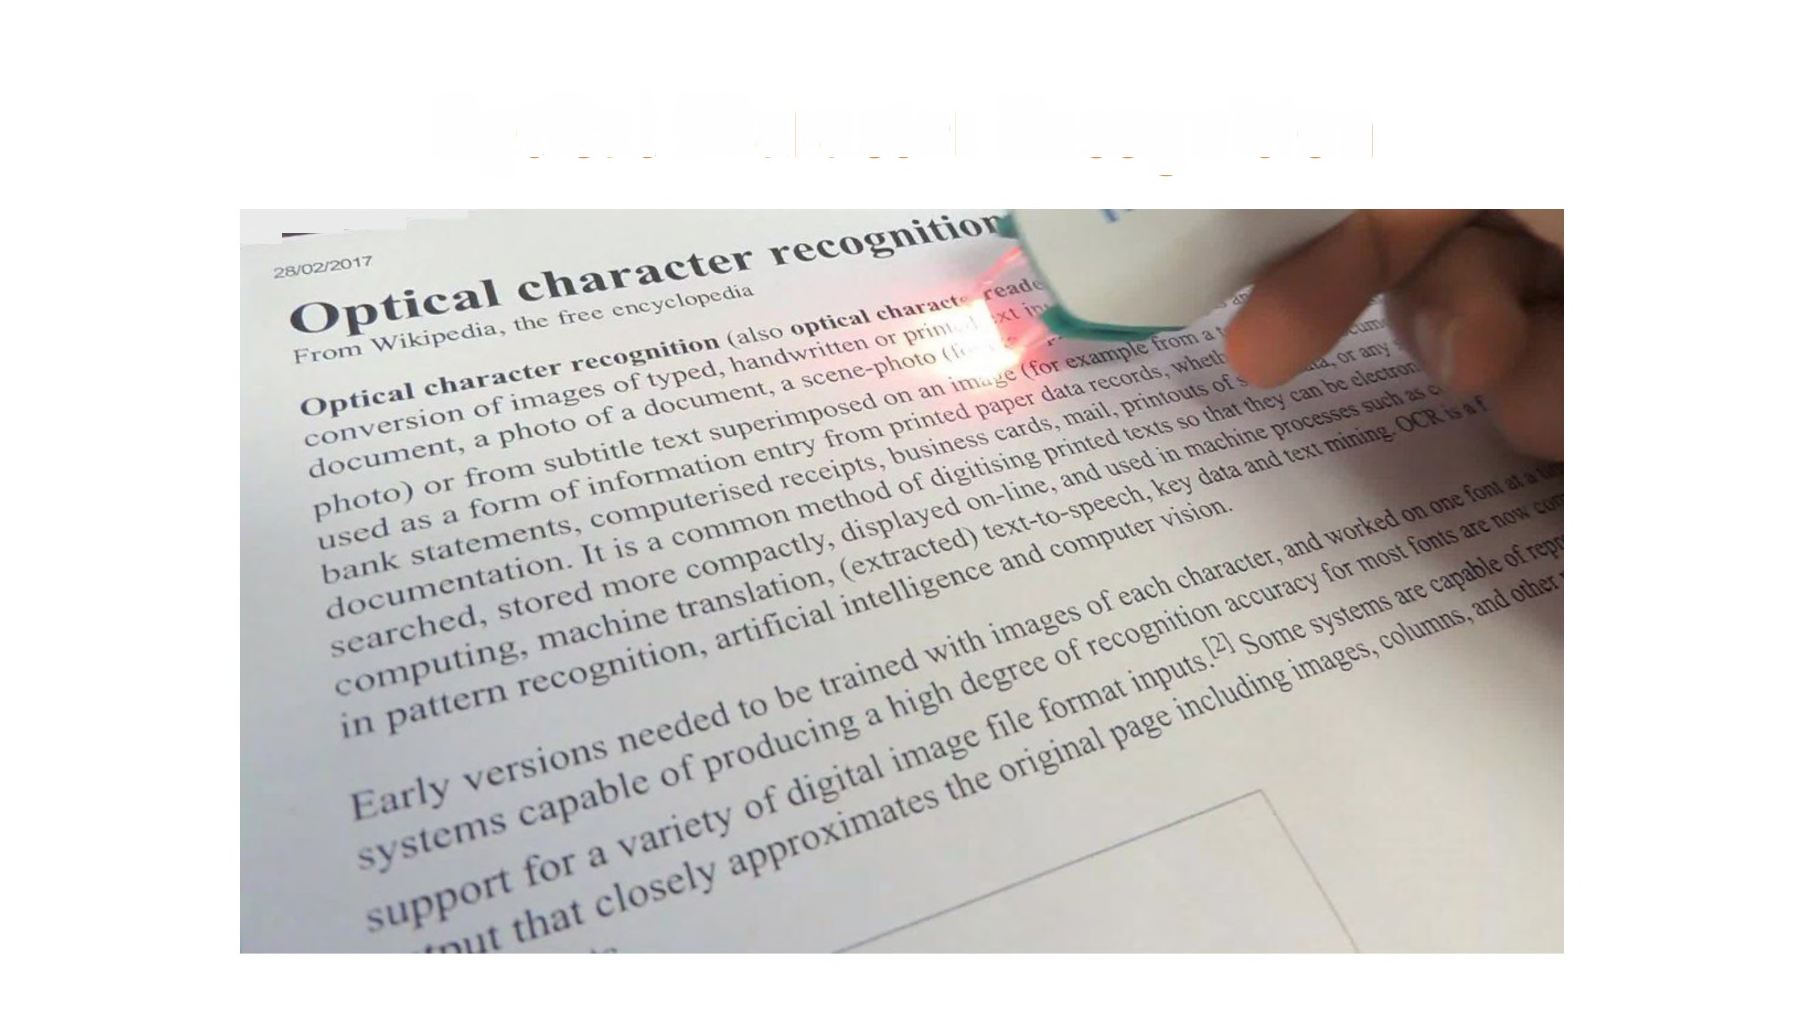
Optical Character Recognition
----
Notes:
Supervised (Classification)

Slide 14

Speech
Recognition
abc
Notes:
Supervised (Classification)

Slide 15
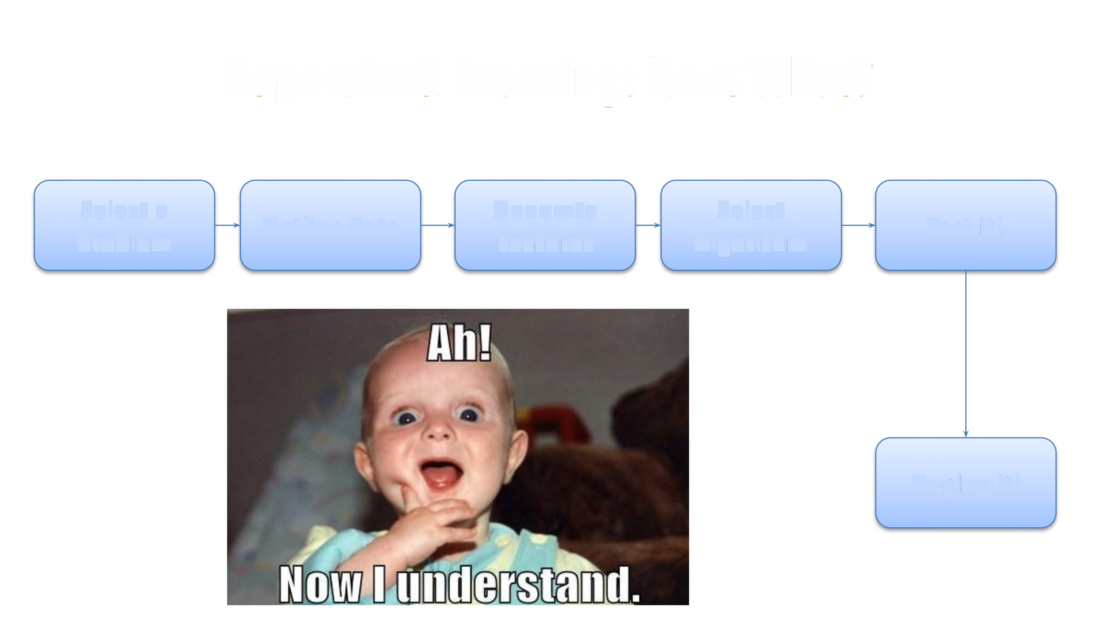
Supervised
Learning:
Next What?
Select a
Problem
Generate
Features
Select
Algorithm
Gather
Data
Test
It!
Deploy it!

Slide 16
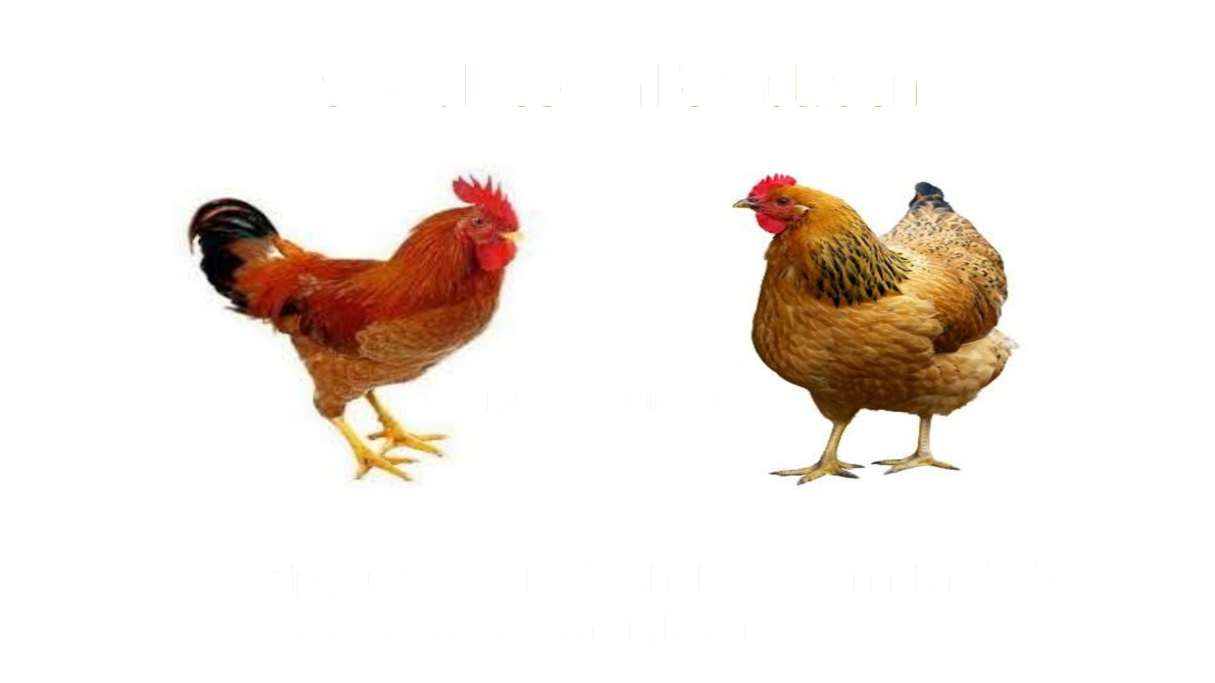
Step
1:
Problem
Formulation
DESHI
VS BIDESHI
Help your Mom! Deshi Chicken
This is a classification problem!
vs Sonalika
Chicken

Slide 17
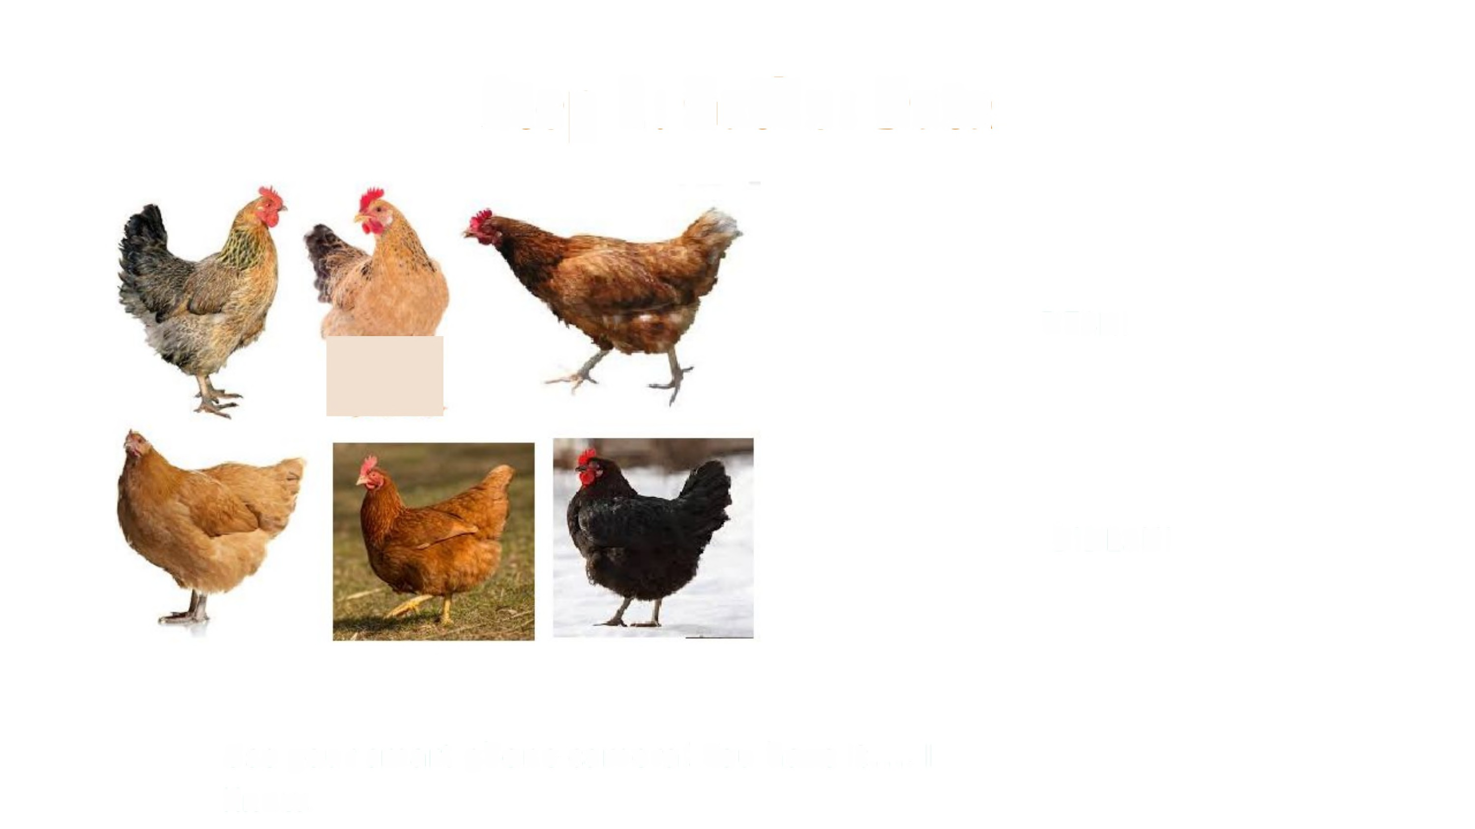
Step
2:
Gather
Data
TI
DESHI
BIDESHI
Use your smart
Know.
phone camera! You have it .... I

Slide 18

Step
3:
Featurization
•
•
•
•
•
•
Color
Comb
Hackle
Saddle
Claw
Sickle Feather
•
•
And if nothing
pixels!

Slide 19
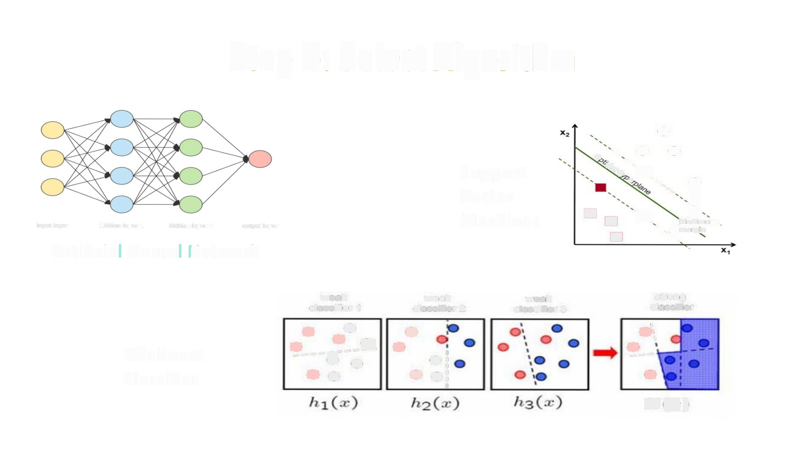
Step
4:
Select
Algorithm
º.'<^{O}
0
O
@a, «
~
Support
Vector
Machines
'-,,, ~
•
L
>
Mi»arum
[
L
ml
input layer
hidden layer 1
hidden layer 2
output layer
• lmargin
Artificia
Neural
Network
weak classifier 1
e
weak classifier 2
..^{O'I}
weak classifier 3
strong classifier
º----.@--_.^{g}
•
0
4
G
G•
\
Adaboost
Classifier
⁰-- -
0O
Oe
:
'
He)

Slide 20
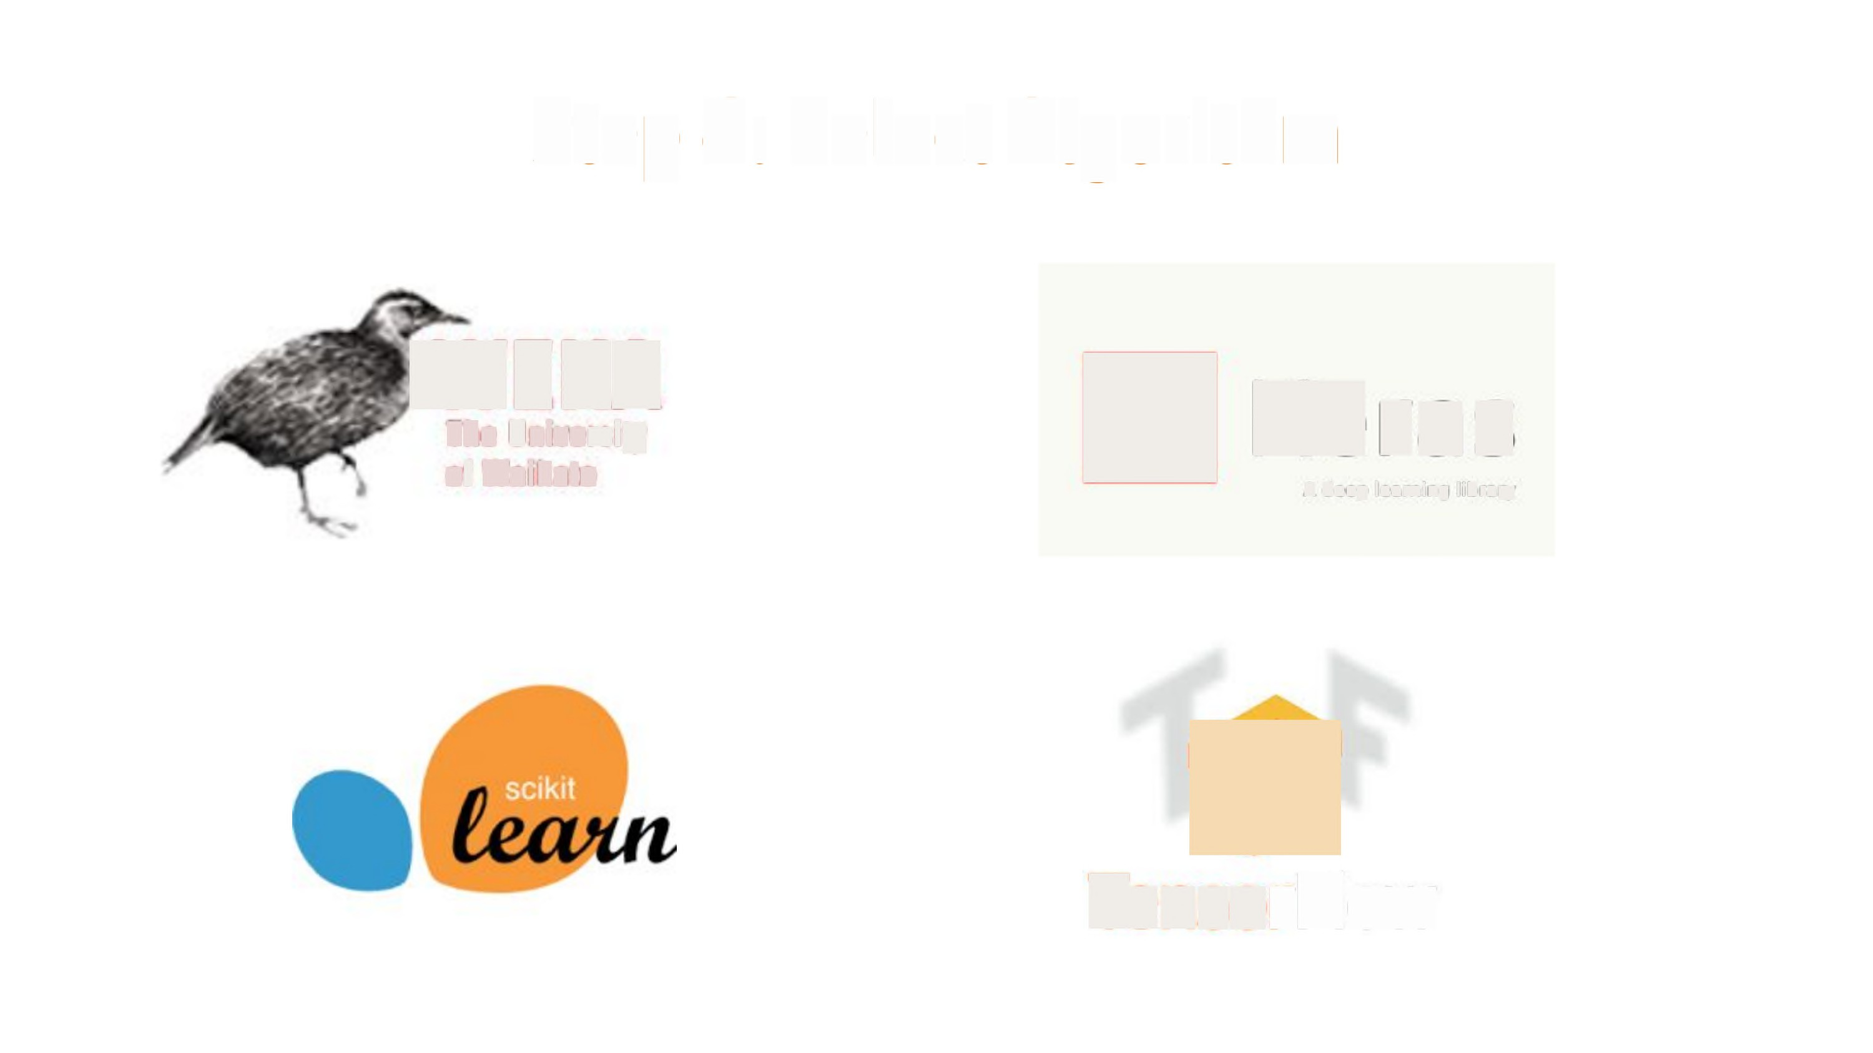
Step
4:
Select
Algorithm
WEKA
The University
of Waikato
[
Kras
A deep learning library
F
TensorFlow

Slide 21
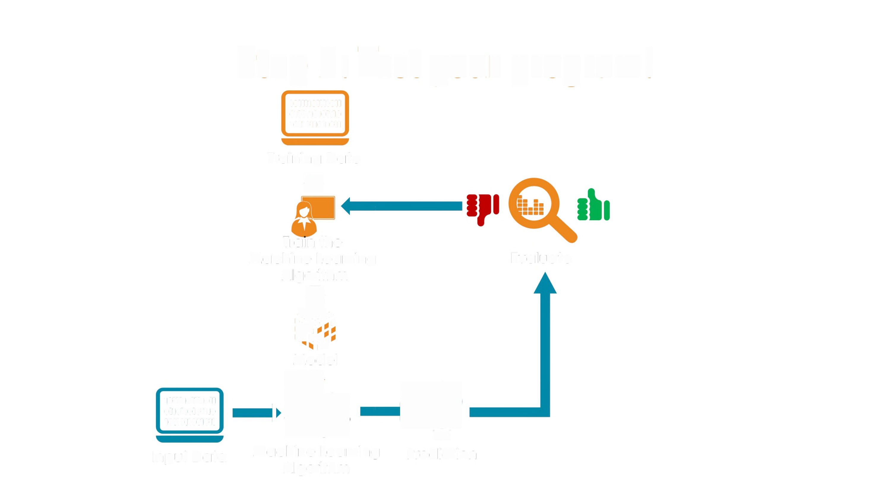
Step 5: Test
10111101111011
0110110101110
1011011011011
your
program!
Training Data
4
Train the
Machine Learning
Algorithm
.. ···-
Evaluate
~
.%%
^{'i}'
»8,
Model
ot
•-
10111101111011
0110110101110
1011011011011
Input Data
Machine Learning
Algorithm
Prediction

Slide 22

Step
6:
Deployment
Make
it usable for your Mom!
This is what the
big guys are doing?
Well, mostly!

Slide 23

Machine Learning
1.
2.
Clearly define the machine learning task, T, E, P
Collect Data, samples, instances [sometimes
with
labels]
a.
Preprocessing, Cleaning
3.
Feature Engineering
a.
Normalization, feature creation,
feature selection
4.
5.
6.
Model / Algorithms
Testing
Deployment

Slide 24

Machine
Learning
Data
•
Structured
o
Nominal/ Categorical
Ordinal (rating, score)
Numerical
Time Series
o
•
Unstructured
O Text, images, video
Labels
•
^{f}. .,
Discrete I Continuous
Unlabelled

Slide 25
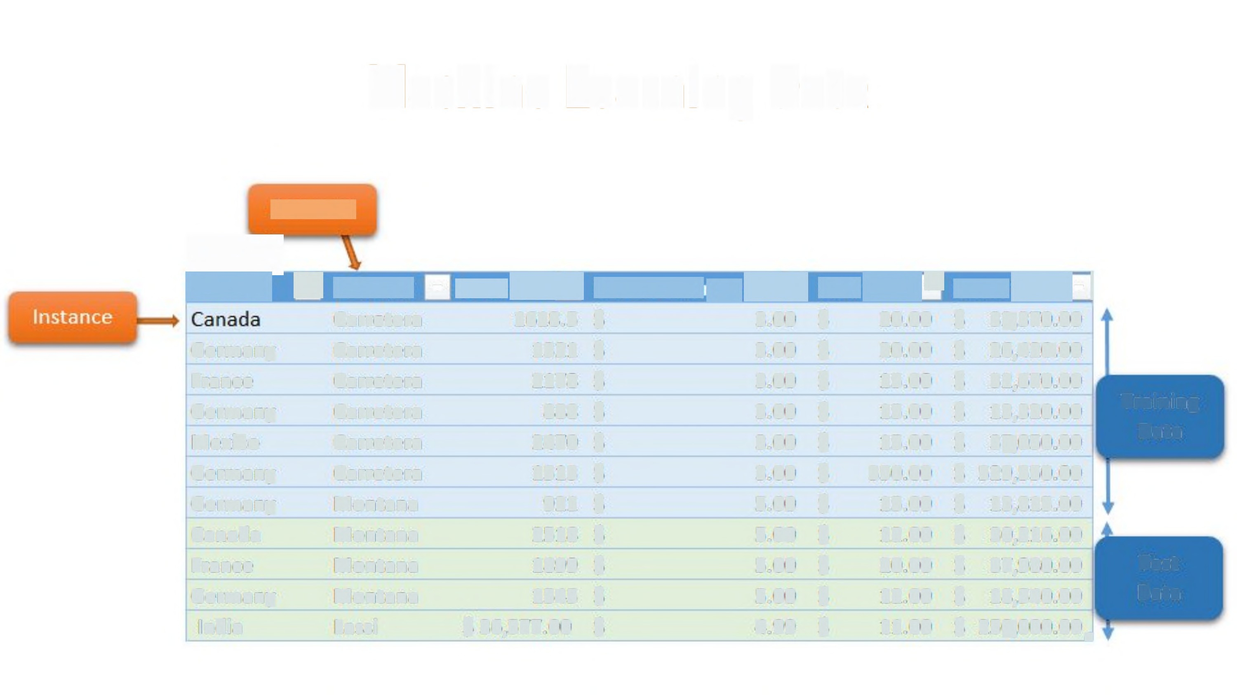
Machine
Learning
Data
[ZEIS)
EH
Germany
France
Germany
Mexico
Germany
Germany
Canada
France
Germany
India
[·
3
Carretera
Carretera
Carretera
Carretera
Carretera
Carretera
Montana
Montana
Montana
Montana
Lassi
-
DEE!EE ·
1618.5
1321
2178
888
2470
1513
921
2518
1899
1545
$ 36,577.00
C'ZIETZ-:
ETET-
TECH-]
$
$
$
$
$
$
$
$
$
$
$
3.00
3.00
3.00
3.00
3.00
3.00
5.00
5.00
5.00
5.00
4.99
S
$
$
$
$
$
$
$
$
$
$
20.00
20.00
15.00
15.00
15.00
350.00
15.00
12.00
20.00
12.00
11.00
$
$
$
$
$
$
$
$
$
$
$
32,370.00
26,420.00
32,670.00
13,320.00
37,050.00
529,550.00
13,815.00
30,216.00
37,980.00
18,540.00
250,000.00 •
Training
Data
Test
Data

Slide 26
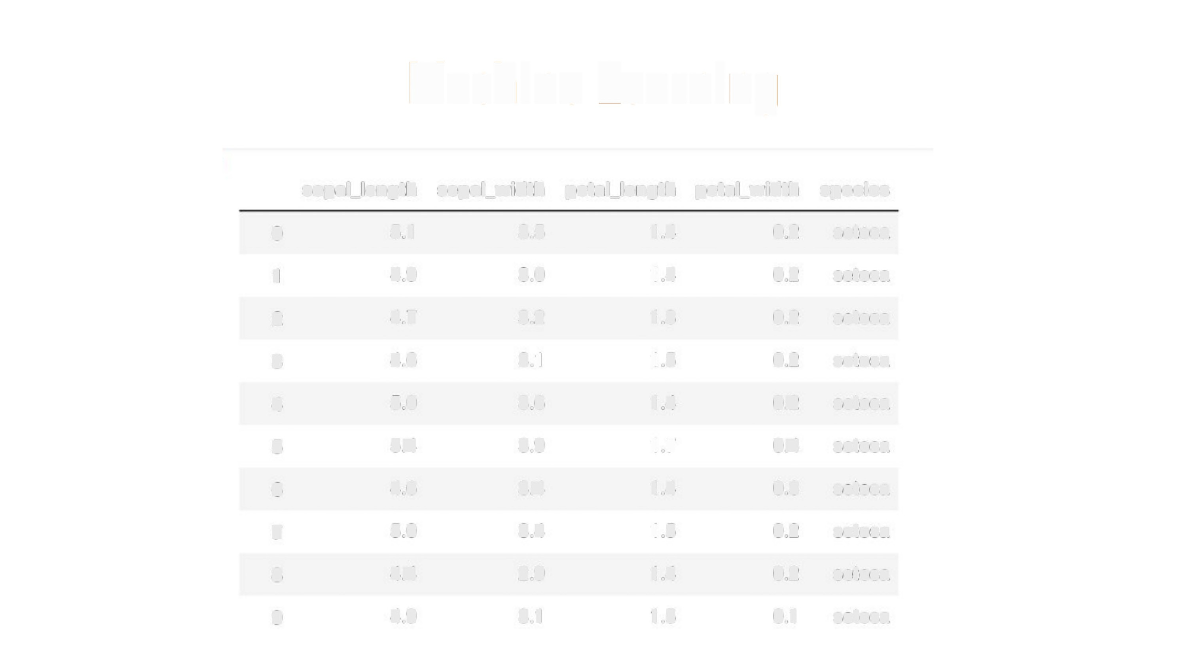
Machine Learning
sepal_length
sepal_width
petal_length
petal_width
species
0
5.1
4.9
4.7
3.5
3.0
3.2
1.4
1.4
1.3
0.2
0.2
0.2
setosa
1
setosa
2
setosa
3
4.6
5.0
5.4
4.6
5.0
4.4
4.9
3.1
3.6
3.9
3.4
3.4
2.9
3.1
1.5
1.4
1.7
1.4
1.5
1.4
1.5
0.2
0.2
setosa
4
setosa
5
0.4
0.3
0.2
0.2
0.1
setosa
6
setosa
7
setosa
8
setosa
9
setosa

Slide 27
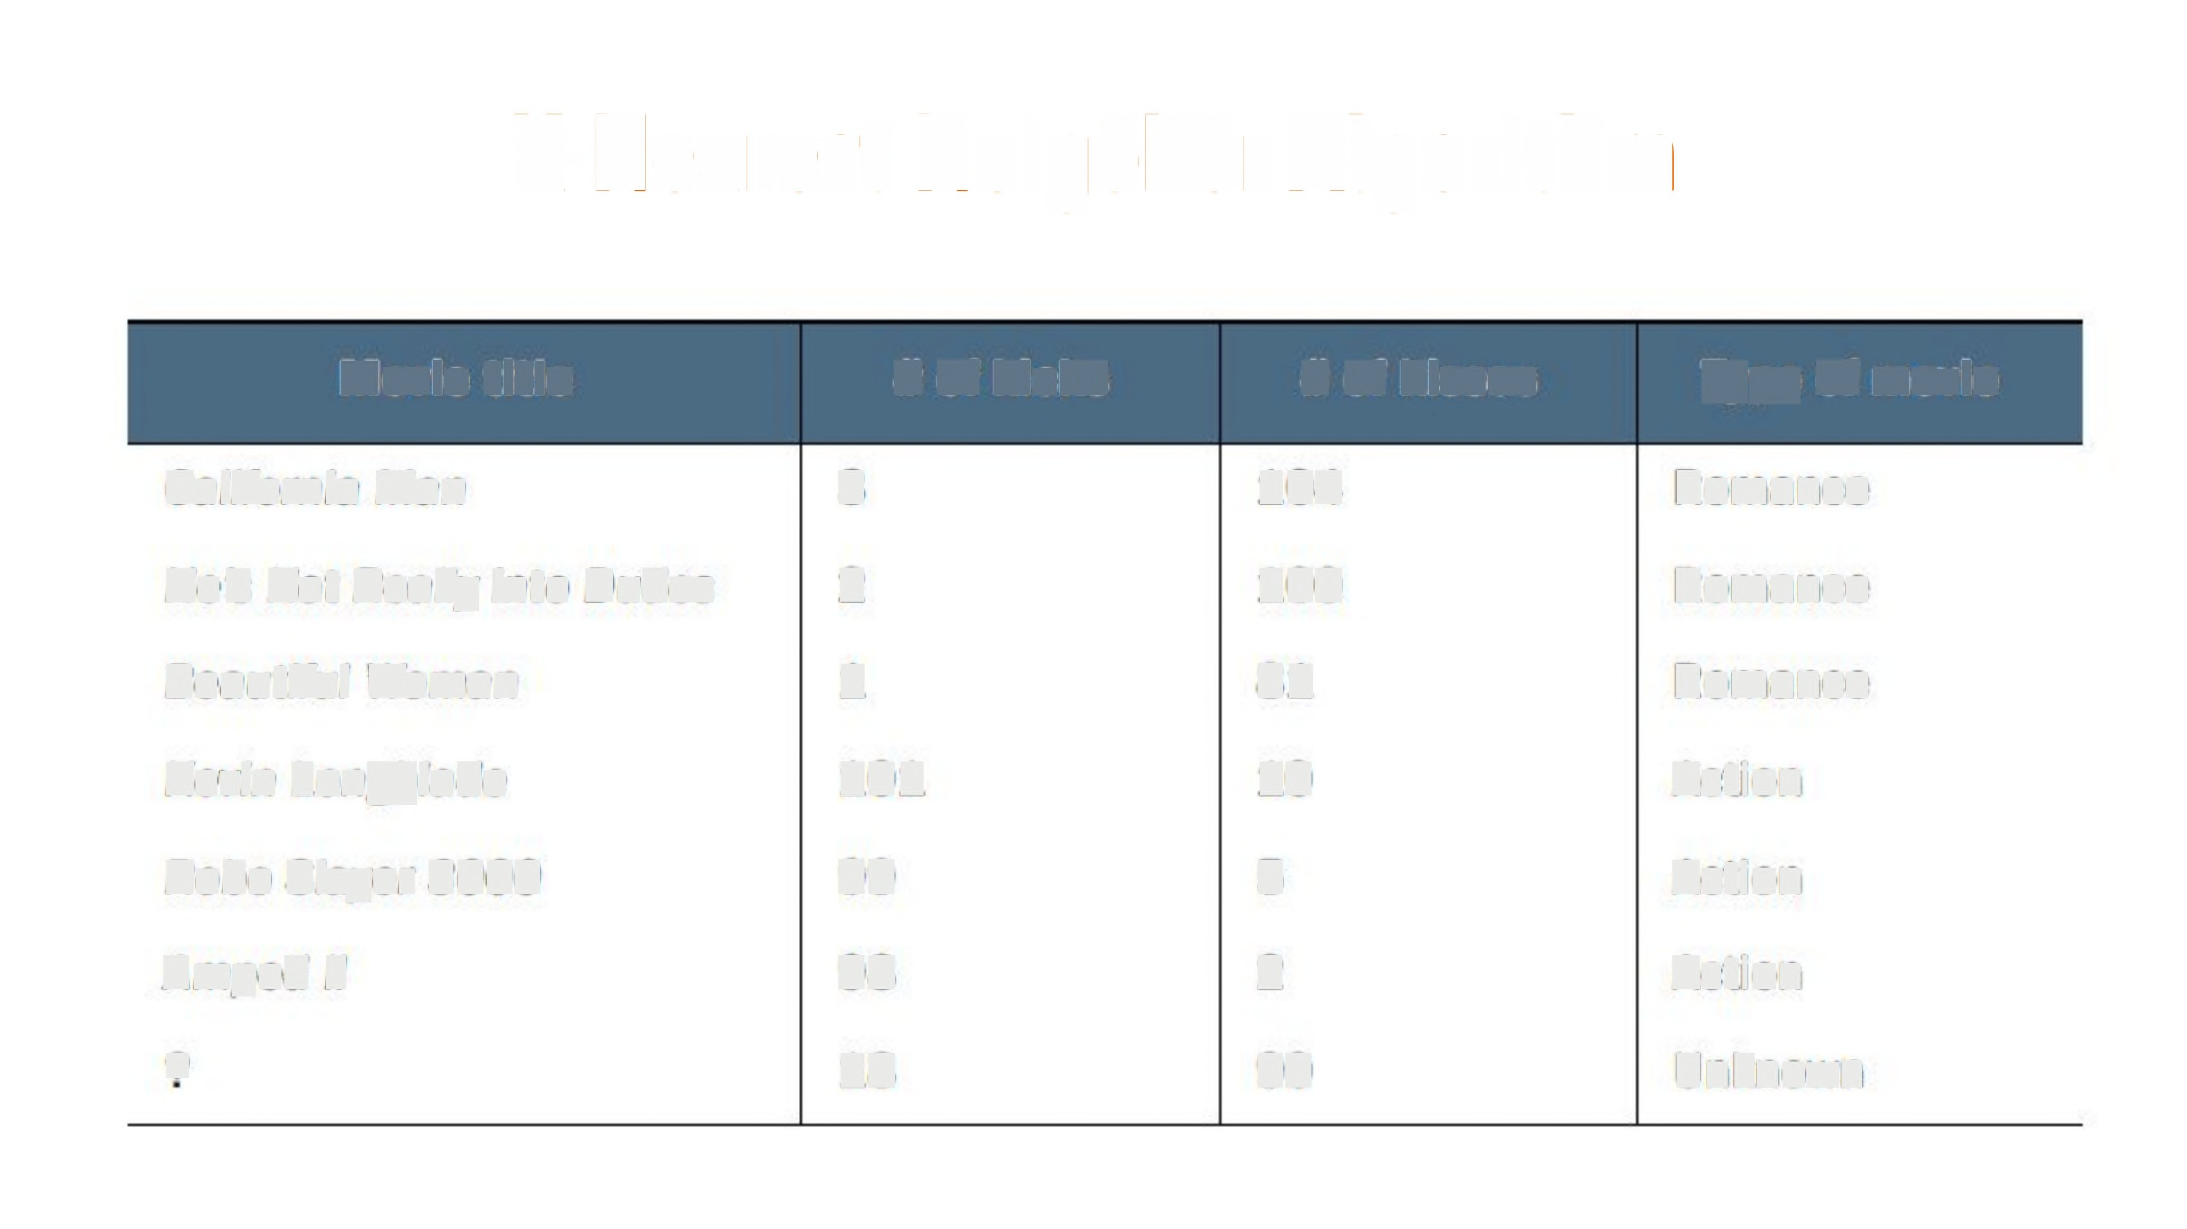
K-Nearest Neigbhor Algorithm
Movie title
# of kicks
# of
kisses
Type of movie
California Man
3
104
100
81
10
5
Romance
He's Not Really into
Dudes
2
Romance
Beautiful Woman
1
101
99
98
18
Romance
Kevin Longblade
Action
Robo Slayer 3000
Action
Amped II
2
Action
2
90
Unknown

Slide 28
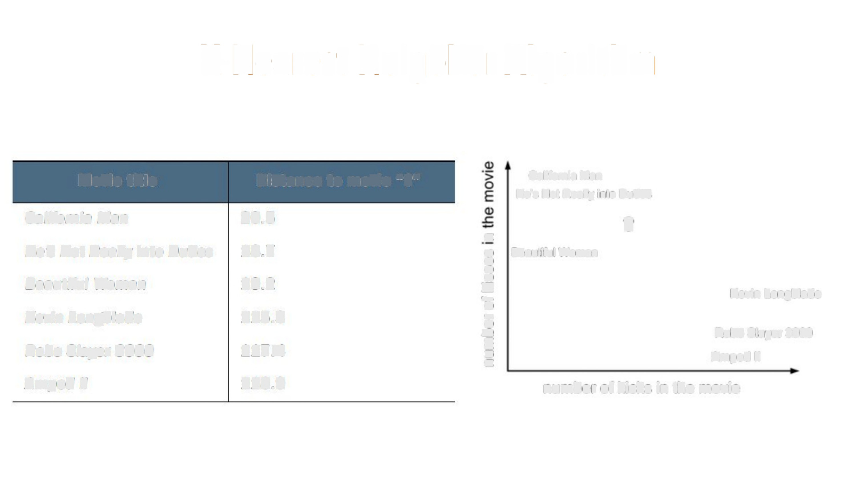
K-Nearest Neigbhor
Algorithm
Movie title
Distance to movie "2"
California Man
He's Not Really into Dudes
California Man
20.5
?
c
o
0
(/)
(/)
5
•0
\-
Q)
.0
E
2
c
He's Not Really into Dudes 18.7
19.2
Beautiful Woman
Beautiful Woman
Kevin Longblade
Kevin Longblade
115.3
117.4
118.9
Robo Slayer 3000
Amped II
Robo Slayer 3000
Amped II
number of kicks in the movie

Slide 29
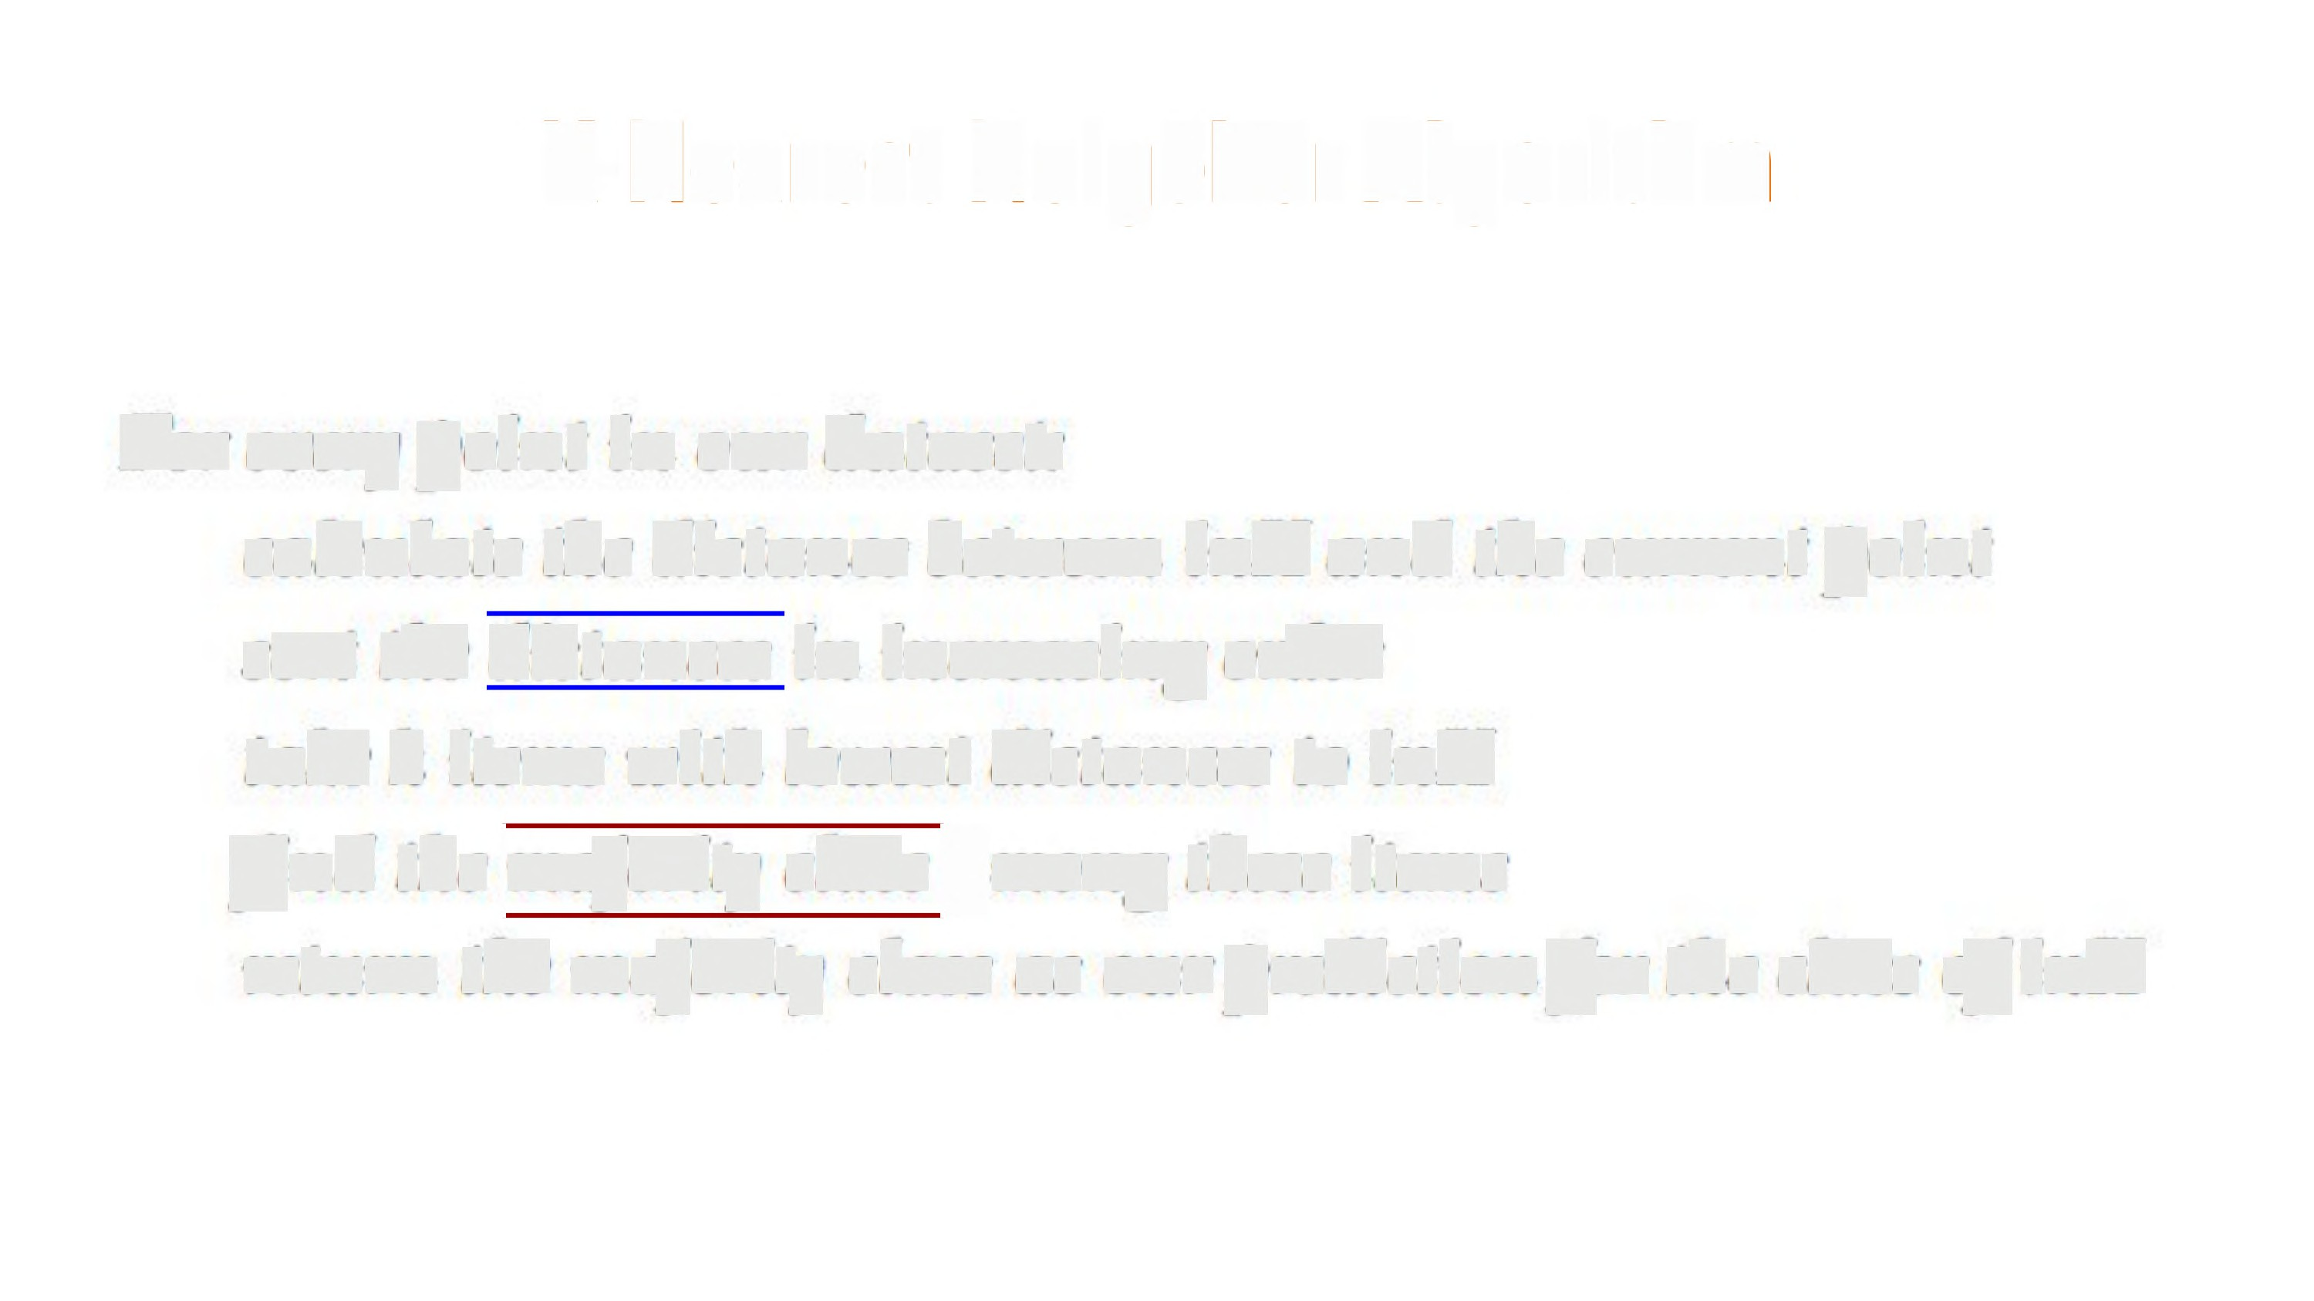
K-Nearest Neigbhor Algorithm
For every point in our dataset:
calculate the distance between inX and the current
sort the \distances]in increasing order
take k items with lowest distances to inX
find the]majority class]among these items
point
return the majority class as our prediction for the class ofinX

Slide 30
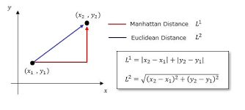
K-Nearest Neighbor Algorithm
•
Non parametric method
Can not be characterized by a set of parameters.
Do not make any assumption
about the functional
form
/
•
Distances
Euclidean Distance
5
5
4
4
Euclidean
distance=1
•
Manhattan distance=1
e
f
Manhattan
Distance
3
• ª
@
3
,^{r}.⁻1..
(N
¢
(u
¢
2
Co
2
•
•
•
1
b
1
0
0
1
3
5
0
0
2
2
4
1
3
4
5
X1

Slide 31
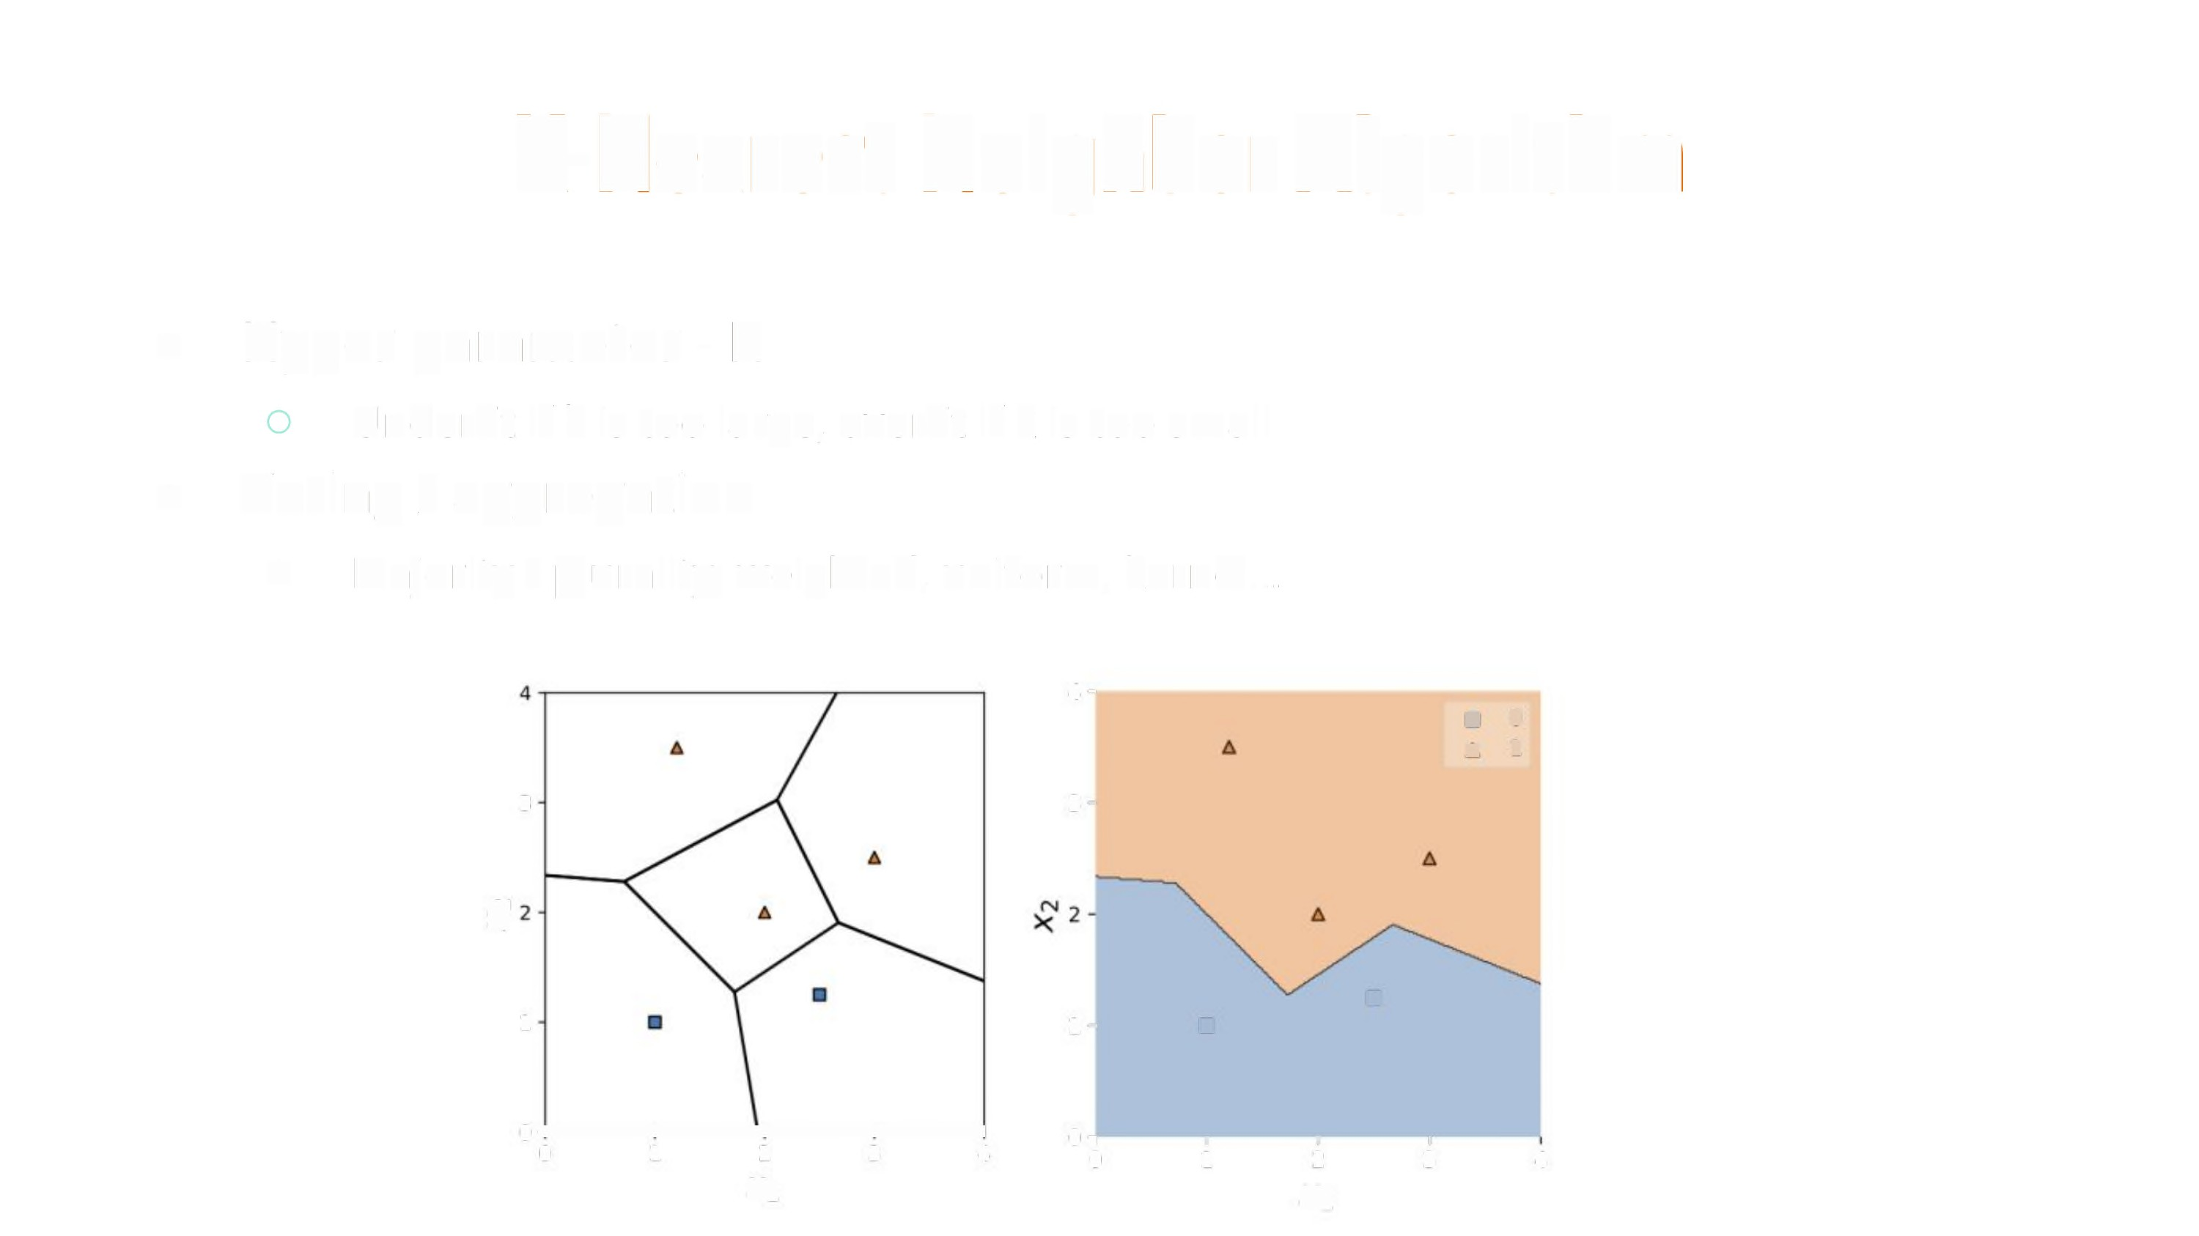
K-Nearest Neighbor
Algorithm
•
Hyper para meter - K
Underfit if k is too large, overfit if k is too small
Voting/ aggregation
•
o
Majority /
plurality, weighted,
uniform,
kernel...
4•
a
A
0
1
3
3•
£
•
1
1•
•
}.t
fl ,
O
I
1
I
2
X
I
3
0
1
2
X
3
4
4

Slide 32
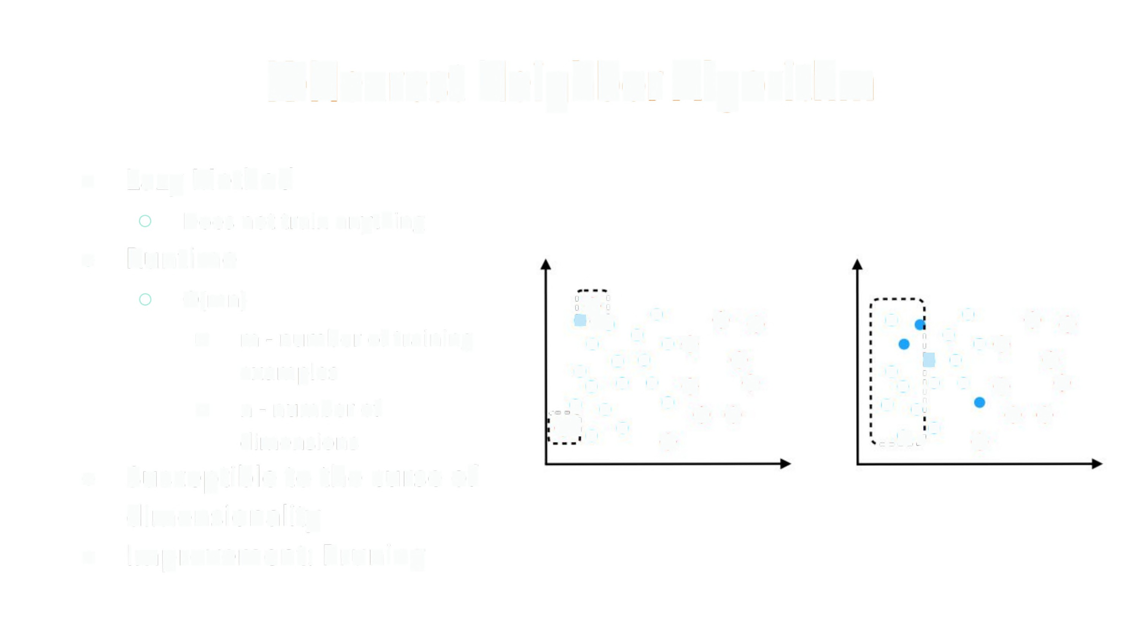
K-Nearest
Neighbor
Algorithm
•
Lazy Method
Does not train
Runtime
0(mn)
anything
•
'I $'I
'•-
• •••
.
$.
•.
^{e}.
■
m
- number of training
¢ ¢
•
; ° •e¢
^{'I}:•
¢ ¢
••
•• •
•
examples
n - number of dimensions
• • ° •
■
...9? e
¢
¢
• e}
¢ ¢
;% " %
.•:°
%
•
Susceptible to the curse of
dimensionality
Improvement: Pruning
•

